Slide 1
Configuring Data Protection Modes

Slide 2
Objectives
After completing this lesson, you should be able to:
  Describe the data protection modes
  Change the data protection mode of your configuration

Slide 3




Data Protection Modes and
Redo Transport Modes
  A data protection mode requires a specific redo transport mode.
  A redo transport mode alone does not define a data protection mode.
Notes:
Data Protection Modes and Redo Transport Modes
When you define a redo transport mode, you are configuring the shipment of log files from the primary database to the standby database (physical or logical). You must set your redo transport mode to support the protection mode that you want for your configuration. However, configuring the redo transport mode alone does not set up the protection mode.
After setting up the redo transport mode, you can put the configuration into a data protection mode. The data protection mode setting causes internal rules to be implemented, ensuring that your configuration is protected at the necessary level.

Slide 4

Data Protection Modes
  Three data protection modes:
    Maximum protection
    Maximum availability
    Maximum performance
  Help to balance data availability and system performance
Notes:
Oracle Database 11g: Data Guard Administration 7 - <number>
Data Protection Modes
Oracle Data Guard offers maximum protection, maximum availability, and maximum performance modes to help enterprises balance data availability against system performance requirements.
In some situations, a business cannot afford to lose data. In other situations, the availability of the database may be more important than the loss of data. Some applications require maximum database performance and can tolerate the potential loss of data.

Slide 5
Maximum Protection Mode
  Maximum protection mode ensures zero data loss in the event of a failure of the primary database, the network, or all standby databases.
  The primary database shuts down if a fault prevents it from writing its redo stream to at least one synchronized standby database.
  Redo data must be written to both the local online redo log and the standby redo log on at least one synchronized standby database.
  Configuration requirements: At least one standby database must have a standby redo log, and that standby database destination must be configured with the SYNC and AFFIRM redo transport attributes.
Notes:
Maximum Protection Mode
This protection mode ensures that no data loss occurs if the primary database fails. To provide this level of protection, the redo data that is needed to recover each transaction must be written to both the local online redo log and the standby redo log on at least one standby database before the transaction commits. To ensure that data loss cannot occur, the primary database shuts down if a fault prevents it from writing its redo stream to at least one remote standby redo log. For multiple-instance RAC databases, Data Guard shuts down the primary database if it is unable to write the redo records to at least one properly configured database instance.
Maximum protection mode requirements:
Configure standby redo log files on at least one standby database.
Set the SYNC and AFFIRM attributes of the LOG_ARCHIVE_DEST_n parameter for at least one standby database destination.
Note: Oracle recommends a minimum of two standby databases for maximum protection mode.

Slide 6
Maximum Availability Mode
  Maximum availability mode ensures zero data loss without compromising the availability of the primary database.
  Redo data must be written to both the local online redo log and the standby redo log on at least one synchronized standby database.
  The primary database does not shut down if it cannot write to at least one synchronized standby database.
  If no synchronized standby databases are available, the primary database operates in an unsynchronized mode until at least one standby database is synchronized.
  Configuration requirements: At least one standby database must have a standby redo log, and that standby database destination must be configured with the SYNC and AFFIRM redo transport attributes.
Notes:
Maximum Availability Mode
This protection mode provides the highest possible level of data protection without compromising the availability of the primary database. A transaction does not commit until the redo that is needed to recover that transaction is written to the local online redo log and to at least one remote standby redo log. The primary database does not shut down if a fault prevents it from writing its redo stream to a remote standby redo log. Instead, the primary database operates in an unsynchronized mode until the fault is corrected and all gaps in redo log files are resolved. When all gaps are resolved and the standby database is synchronized, the primary database automatically resumes operating in maximum availability mode.
This mode guarantees that no data loss occurs if the primary database fails—but only if a second fault does not prevent a complete set of redo data from being sent from the primary database to at least one standby database.
Maximum availability mode requirements:
Configure standby redo log files on at least one standby database.
Set the SYNC and AFFIRM attributes of the LOG_ARCHIVE_DEST_n parameter for at least one standby database.

Slide 7
Maximum Performance Mode
  Maximum performance mode is the default level of data protection.
  This mode provides the highest possible level of data protection without affecting the performance of the primary database.
  Transactions can commit as soon as the redo data is written to the local online redo log.
  Redo data is shipped to the standby database asynchronously with respect to the commitment of the transactions that create the redo data.
  Configuration requirements:
    Standby redo log on at least one standby database
    At least one standby database that is configured with the ASYNC and NOAFFIRM redo transport attributes
Notes:
Maximum Performance Mode
Maximum performance is the default protection mode and provides the highest possible level of data protection without affecting the performance of the primary database. This is accomplished by allowing a transaction to commit as soon as the redo data needed to recover that transaction is written to the local online redo log. The primary database’s redo data is also written to at least one standby database, but that redo data is written asynchronously with respect to the commitment of the transactions that create the redo data.
When network links with sufficient bandwidth are used, this mode provides a level of data protection that approaches that of maximum availability mode with minimal impact on primary database performance.
Maximum performance mode requirement: Set the ASYNC and NOAFFIRM redo transport attributes of the LOG_ARCHIVE_DEST_n parameter on at least one standby database.

Slide 8
Comparing Data Protection Modes
Mode | Risk of Data Loss | Transport | If no acknowledgment is received:
Maximum Protection | Zero data loss Double failure protection | SYNC | Stall primary until an acknowledgement is received
Maximum Availability | Zero data loss | SYNC | Stall primary until threshold period expires, then resume processing
Maximum Performance | Potential for minimal data loss | ASYNC | Primary never waits for standby acknowledgement
Notes:
Comparing Data Protection Modes
Consider the characteristics of each protection mode. You must balance cost, availability, performance, and transaction protection when choosing the protection mode.
Note: If you plan to enable fast-start failover, you must set the protection mode to maximum availability or maximum performance. See the lesson titled “Enabling Fast-Start Failover” for additional information.

Slide 9
Setting the Data Protection Mode by Using DGMGRL
  Configure standby redo logs.
  Set the LogXptMode property (if necessary).
    Maximum protection: SYNC
    Maximum availability: SYNC
    Maximum performance: ASYNC
  Set the data protection mode.
DGMGRL> EDIT DATABASE 'pc00sby1' SET PROPERTY 'LogXptMode'='SYNC';
Property "LogXptMode" updated
DGMGRL> EDIT CONFIGURATION SET PROTECTION MODE AS MAXAVAILABILITY;
Succeeded.
Notes:
Setting the Data Protection Mode by Using DGMGRL
1. If you are setting the protection mode to maximum protection or maximum availability, ensure that standby redo log files are configured on the standby database. You must also configure standby redo log files for the primary database or another standby database in the configuration to ensure that it can support the chosen protection mode after a switchover.
2. Use the EDIT DATABASE SET PROPERTY command to set the redo transport mode for the standby database. For example, if you are changing the data protection mode to maximum availability, use the EDIT DATABASE command to specify SYNC for redo transport services:
DGMGRL> EDIT DATABASE 'DR_Sales' SET PROPERTY 'LogXptMode'='SYNC';
You must also set the redo transport services for the primary database or another standby database in the configuration to ensure that it can support the chosen protection mode after a switchover.
3. Use the EDIT CONFIGURATION SET PROTECTION MODE AS command to set the overall configuration protection mode. To set the protection mode to maximum availability, use the following command:
DGMGRL> EDIT CONFIGURATION SET PROTECTION MODE AS MAXAVAILABILITY;

Slide 10
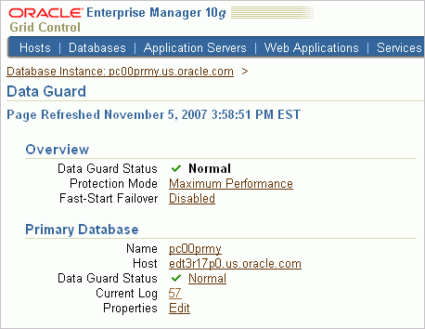
Setting the Data Protection Mode
Click the
Protection Mode link.
Notes:
Setting the Data Protection Mode
If the data protection mode that you need requires a standby database to use the SYNC or ASYNC redo transport mode, Enterprise Manager automatically sets the redo transport mode for the primary database and the selected standby databases.
Enterprise Manager automatically determines the correct number and size of standby redo log files that are needed for all databases in the configuration and adds those log files using the directory locations that you specify.
To set the data protection mode with Enterprise Manager:
1. Navigate to the Data Guard page.
2. Click the link in the Protection Mode field to access the Change Protection Mode: Select Mode page.

Slide 11
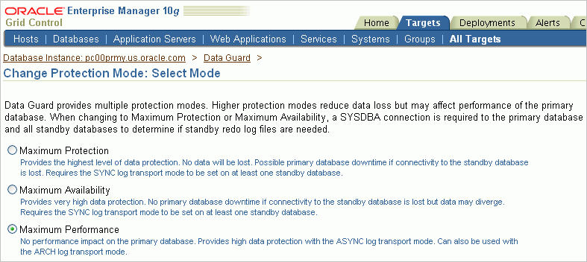
Setting the Data Protection Mode
Notes:
Setting the Data Protection Mode (continued)
3. Select Maximum Protection, Maximum Availability, or Maximum Performance, and click Continue.
4. If prompted, enter the username and password of a user with SYSDBA privileges. Click Login.
5. Select one or more standby databases to support the protection mode that you selected. (If standby redo log files are needed, verify the names of the log files.) Click OK.
6. On the Confirmation page, click Yes.

Slide 12
Summary
In this lesson, you should have learned how to:
  Describe the data protection modes
  Change the data protection mode of your configuration

Slide 13
Practice 7: Overview
This practice covers setting the data protection mode:
  To meet specific business requirements
  By using DGMGRL
  By using Enterprise Manager

